Slide 1
Data Analysis of Adidas U.S. Sales
-By Tejash Rai

Slide 2
Introduction :-
We took a database from kraggle.com based on the sales of Adidas and tried to do certain data analysis.
Our data analysis was based on factors like the sales distribution per region, male- female ratio and the sportswear they try to buy maximum number of times,etc.
We ran our analysis on Newyork state and tired to understand the sales trends .

Slide 3
Sports wear:-
Sportswear is designed for specific activities,providing comfort,support and freedom of movement.
The fabrics include moisture-wicking polyester,spandex for stretch and breathable cotton blends.
The Adidas sportswear is mainly divided into Performance Apparel and Footwear.
Performance Apparel are designed for specific sports like baseball,football ; focusing on breathability and moisture management.

Slide 4
Adidas Footwear is renowned for runing shoes, soccer cleats and lifestyle sneakers, emphasizing comfort and performance.
Adidas incorporates advanced technologies such as;
1)Climacool:- Enhances ventilation and moisture management.
2)Boost:- A cushioning technology for improved energy return in footwear.
3)Parley: A sustainable line made from recycled ocean plastics.

Slide 5
Retailer sales analysis:-
The retailer Westgear sold most units of Adidas including both sportswear and footwear.
That is one area where we can improve customer acquisition by giving discounts and Adidas membership coupons.
Least number of units were sold in Walmart all over America, so that is one area where we can bring in more customers and look forward to improve our sales as it will help in more revenue generation.

Slide 6
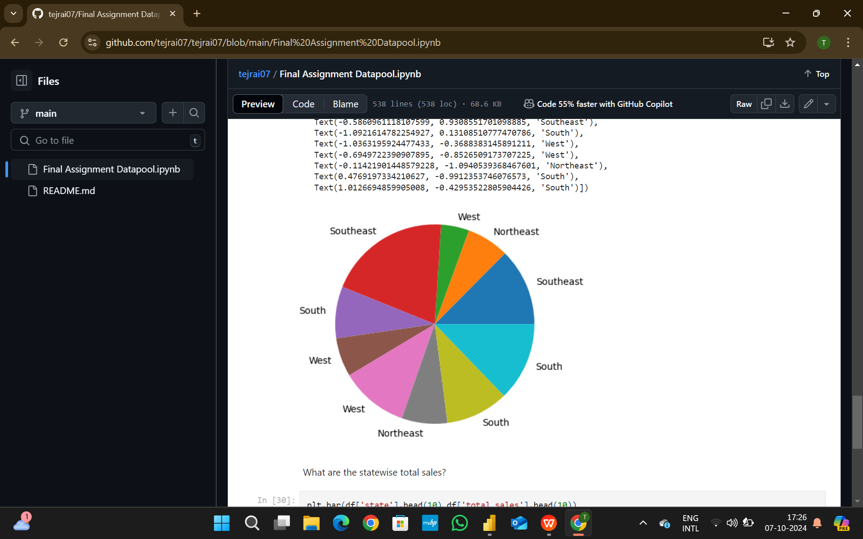
Regiomwise Sales Distribution:-

Slide 7
Southeast region brought in maximum number of sales and put up impressive numbers.
West and Northeast regions were very low comparitively in bringing in sales.
West and South regions were good and average on the numbers.
More sales need to be brought up from west and northeast regions and improvement is needed.
Keeping those areas as target region we need to drive our marketing in an specific order.

Slide 8
Citywise profit distribution-
The city Wilmington generated massive profit of 39,000$ over the year.
This city lies in southeast region and among with other cities of this region generated hefty profit.

Slide 9
Sales method overview:-
Maximum units were sold through online method .
Followed by outlet and In-store sale.
This pays off the work spent in online website and safe online payment methods.
The main reason of online sales hitting maximum is that customers feel the comfort of home and assured quality of the ordered product.
Outlets sales is the only area of minor concern here , that too much change isnt needed as the other methods are putting up impressive numbers

Slide 10
Gender based clothing trends:-
Overall analysis reveals that Mens apparel and footwear have a significant edge over womens sportswear.
This is solely due to male dominated arena of sports.
But mind you, womens sportswear has not hit rock botton but is on a steady rise and has managed to put up good numbers , this shows more female athletes taking up sports and using sportswear in genral.
To expand the sales furthermore, we can invest more in womens section as that field is on a steady rise.

Slide 11
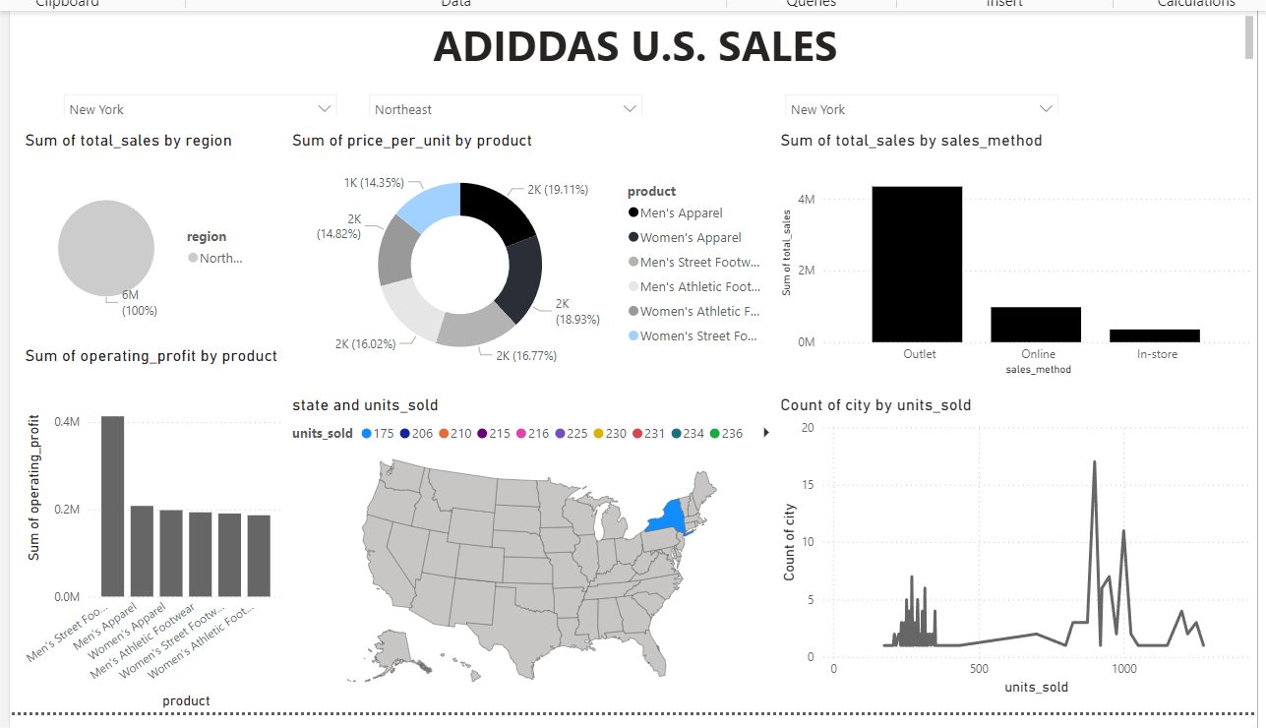
Newyork - dashboad 1

Slide 12
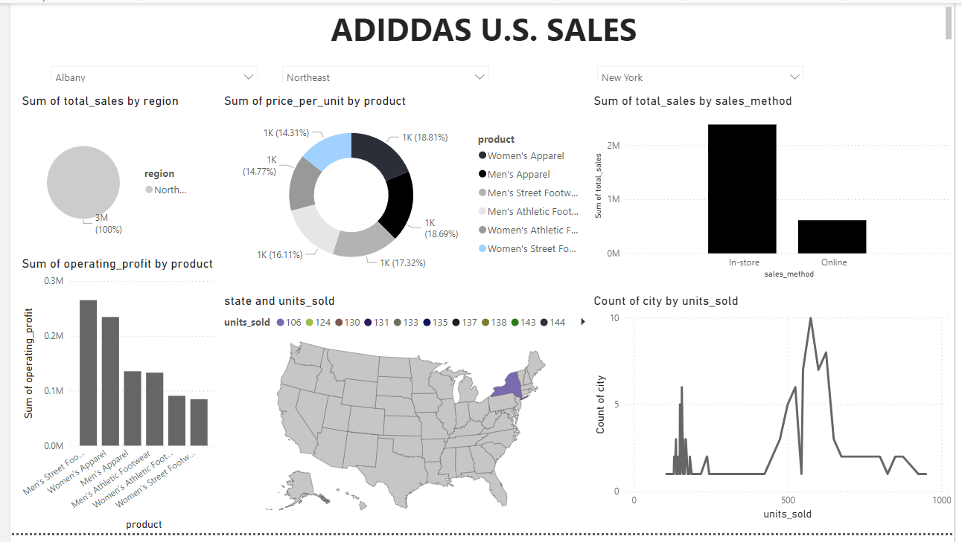
Albany- dashboard 2

Slide 13
Database findings and trends:-
All the data analysis showed to us the picture of the sales in US.
Considering the product type, Mens sports wear has been in a lot of demand but that doesnot mean that womens section has taken a back step, womens sportswear is a section to invest in coming days while continuing the great work currently going in Mens sections.
More expansion of business is needed in Midwest region of US, advertisement and marketing work is needed in that region.
The main work behind popularity of sportswear is sports, therefore the concern is to increase sports facilities and increase amenities.

Slide 14
Adidas products being cost effective and of quality with major sports personalities as brand ambassador, we are on a right track to further expand and increase stronghold in sportswear across whole of America.
As the logo goes, “Impossible is Nothing” quoted by Muhammed Ali, our brand keeps pushing boundaries and motivates people to keep going beyond their limits.

